Slide 1

INGENIOUS
INCUBATING THE IDEAS
Presented By:
Muhammad Hamza Siddiqui
Kashif Mughal

Slide 2
OUR IDEA
This platform will help you to implement your project idea and it will also help you to find the professional candidates required for your project work. It will also help you find Investors to collaborate on your projects.

Slide 3
DESCRIPTION
The Basic idea of this web app is that we are trying to create such type of platform or environment where authenticated users can post their innovative project ideas as well as they can view and request to collaborate in projects posted by any other user. You can then inspect the user who is willing to collaborate with you that either he meets your requirements or not by calling him in an online video interview using WebRTC. Another key feature is that besides the professional support you can also ask for financial support on your idea and any user who likes your idea and wants to invest in your project can reach you. Random users can like your posts and can also provide their precious suggestions for your idea.

Slide 4
Key Features
- Authentication (Google / Email & Password)
- Users’ Professional Profile
- News Feed (Ideas / Projects)
- Collaboration Request Mechanism
- Interview System using WebRTC

Slide 5
Tools & technologies
- React
- Firebase Auth
- Firebase DB
- Git Hub and Git
- Material UI
- Formic
- WebRTC
- Redux
- VS Code

Slide 6
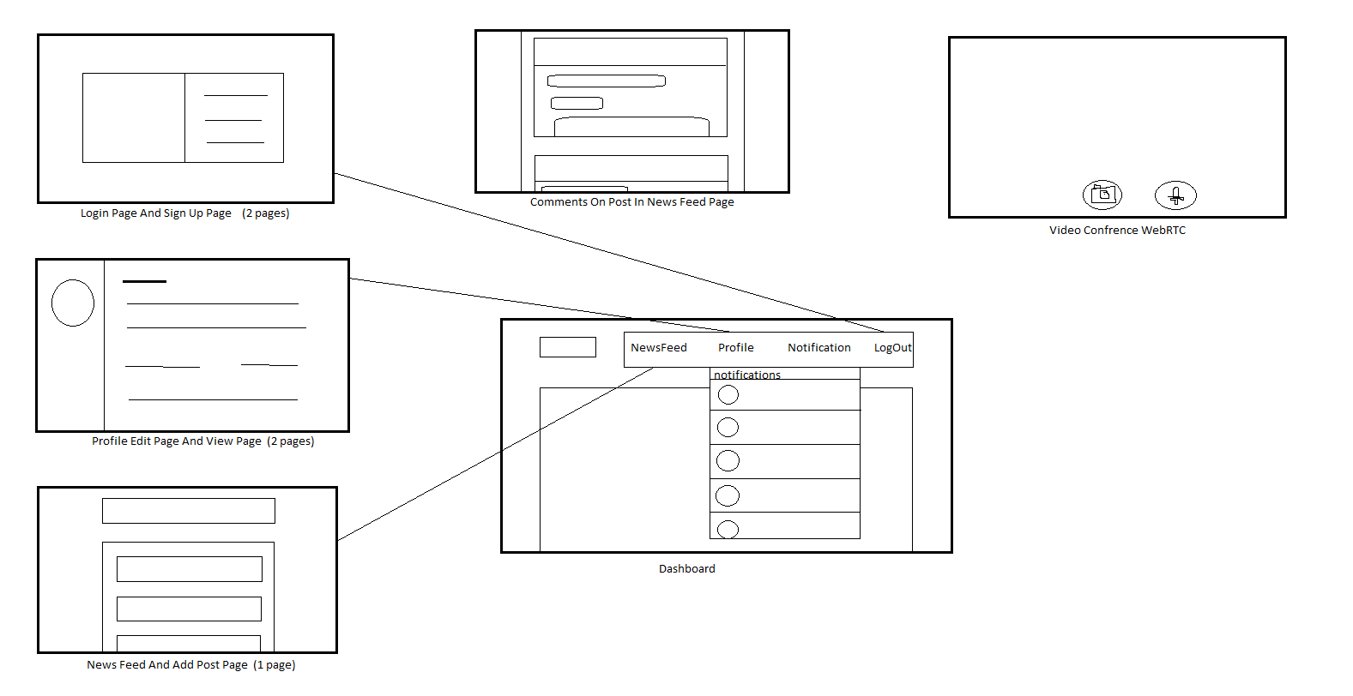
mockup

Slide 7
Link of the site
https://ingenious-ecd53.web.app

